Slide 1

SPRINTER 22 SEATERS
GRACE MATA FUTI
16-08-2024
AEROKLASDUYS

Slide 2
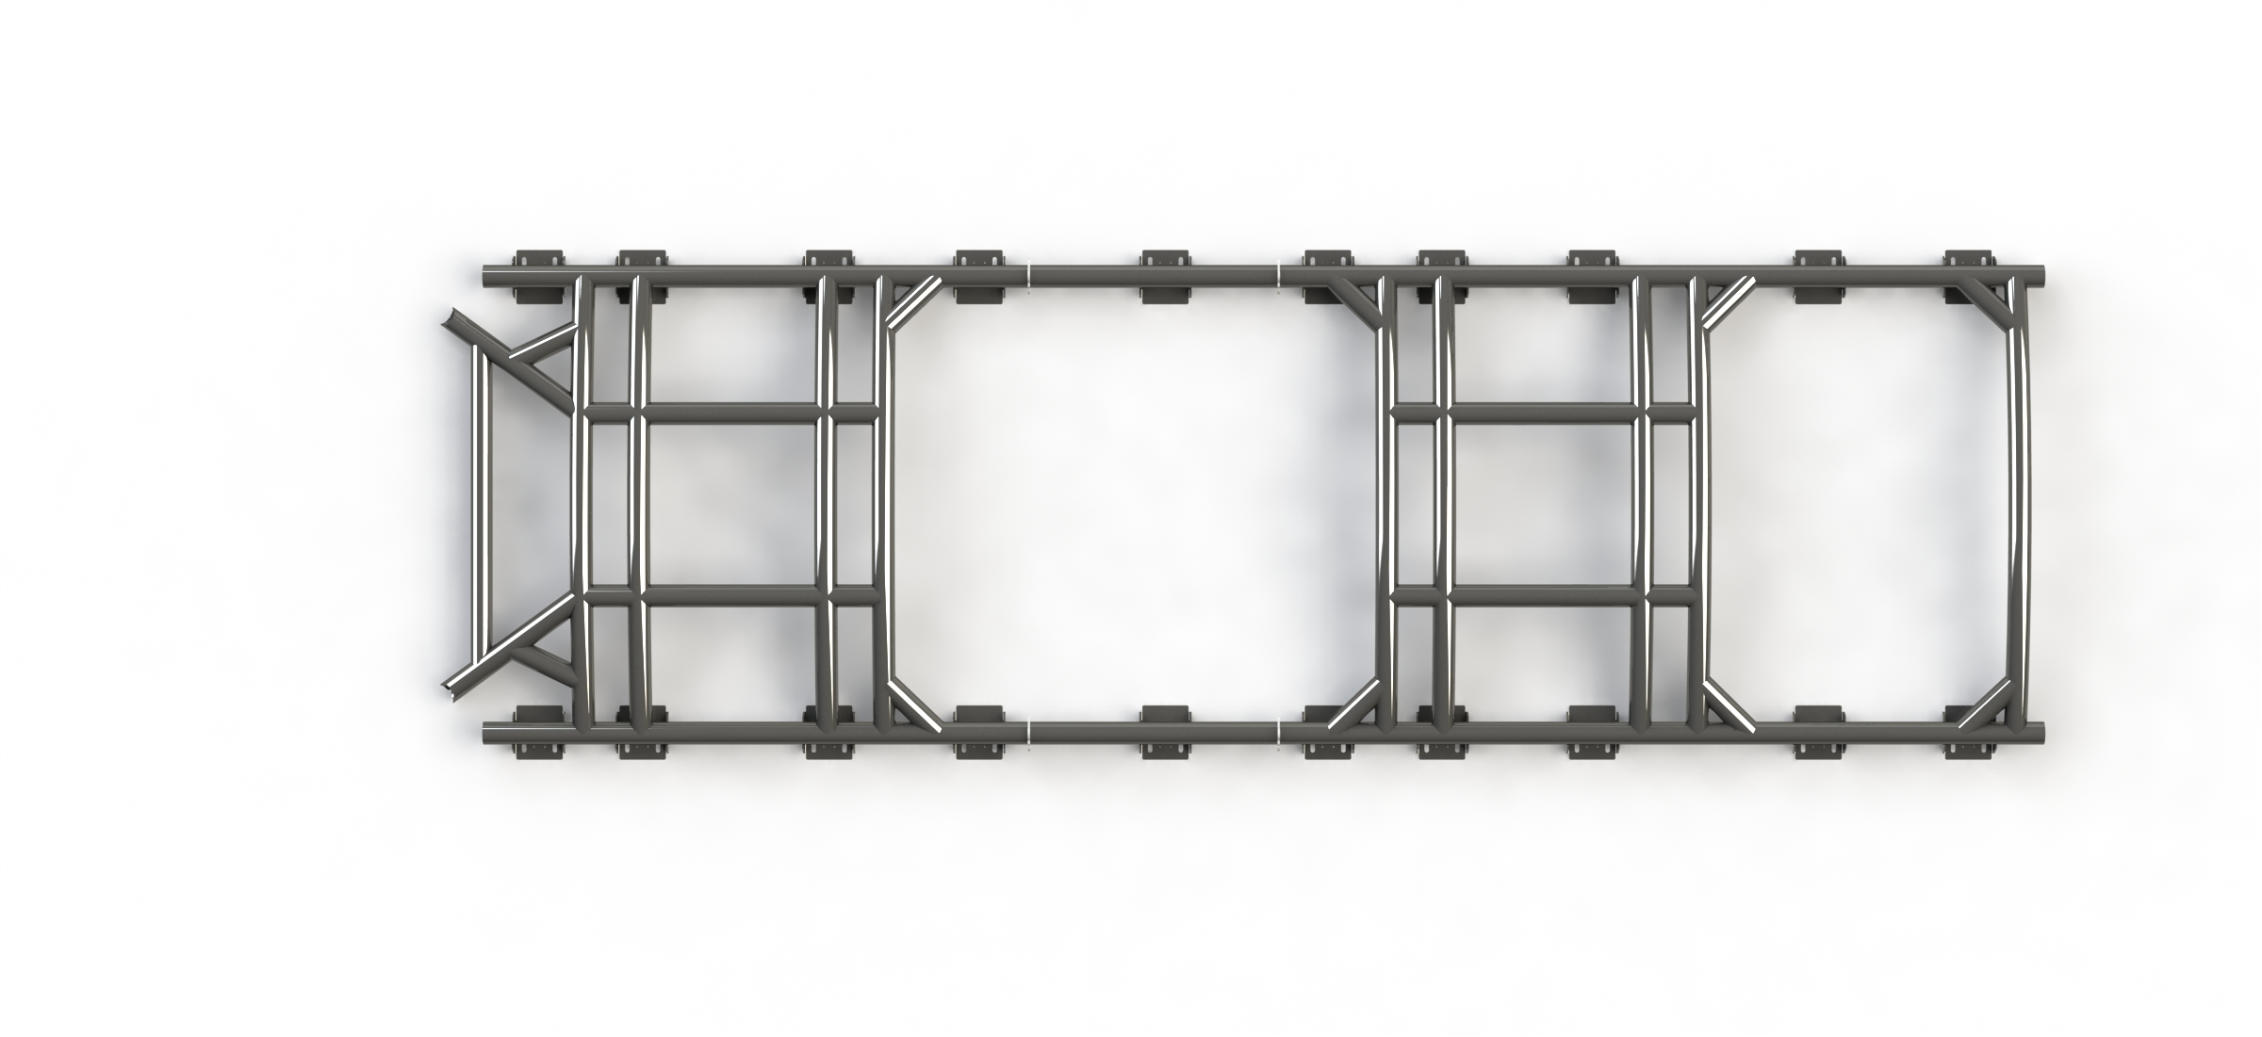
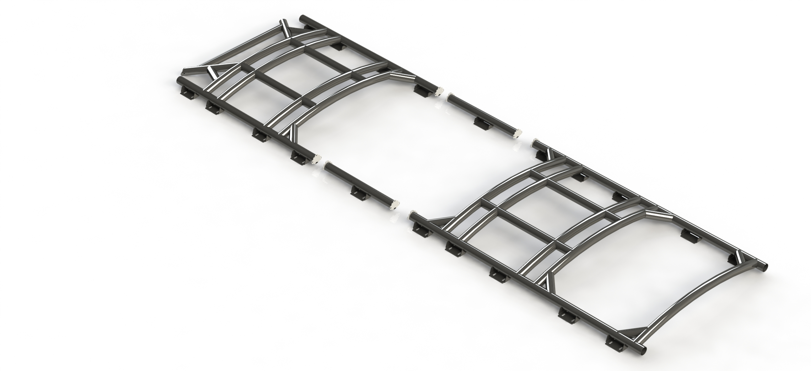
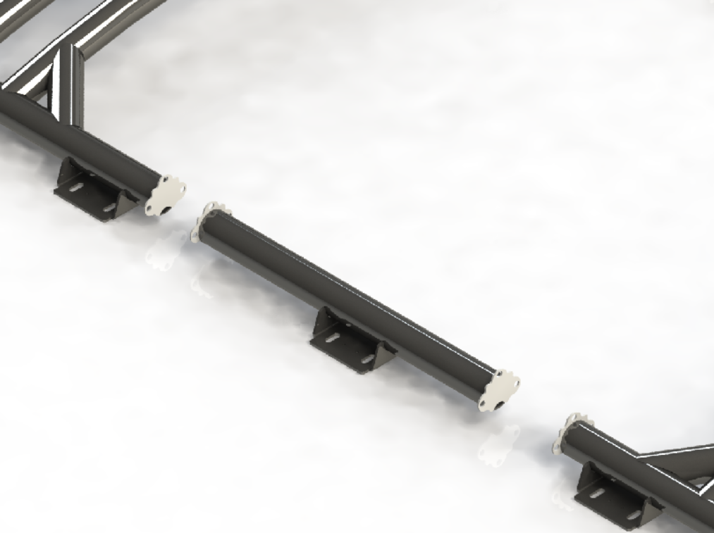
SPRINTER BUS – HALO DESIGN CONCEPT
FRONT HALO
AREA FOR EMERGENCY EXIT
AREA FOR AIRCON UNIT
CONNECTOR
BACK HALO
GRACE MATA FUTI
16-08-2024
AEROKLASDUYS

Slide 3

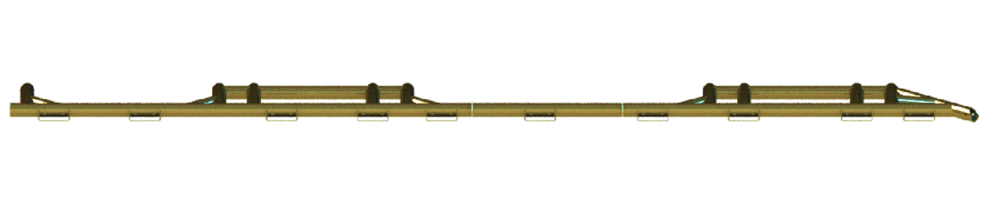
SPRINTER BUS – HALO
SIDE-VIEW
GRACE MATA FUTI
16-08-2024
AEROKLASDUYS

Slide 4
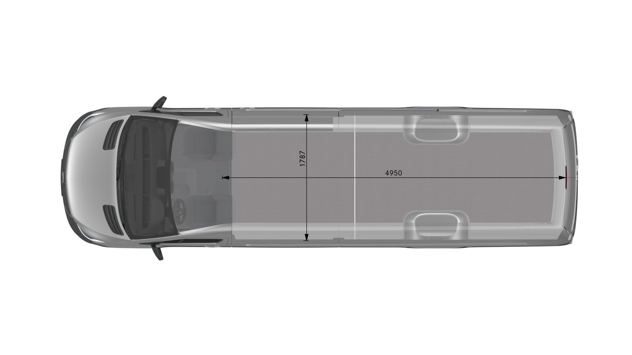
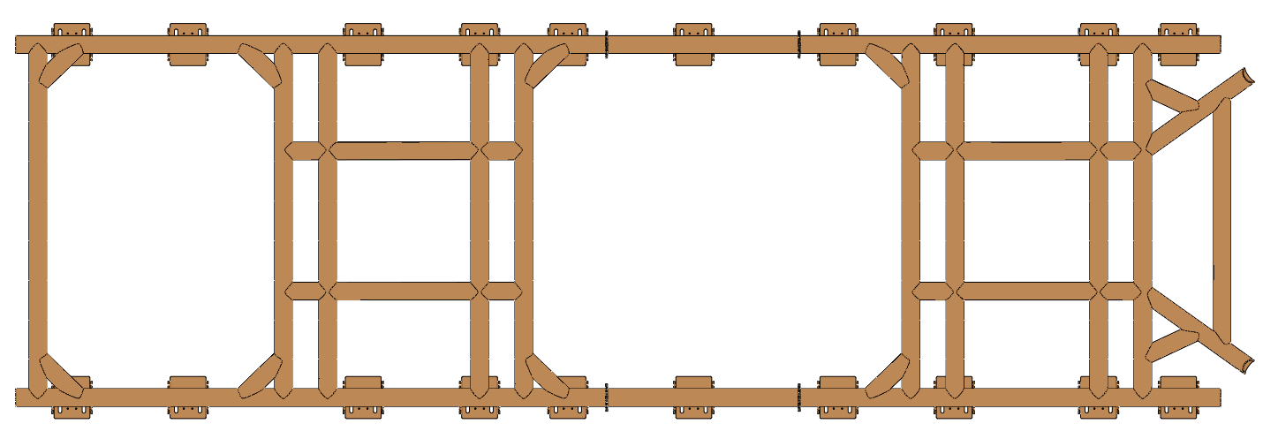
SPRINTER BUS - HALO
TOP-VIEW
AREA FOR EMERGENCY EXIT
AREA FOR AIRCON UNIT
GRACE MATA FUTI
15-08-2024
AEROKLASDUYS

Slide 5
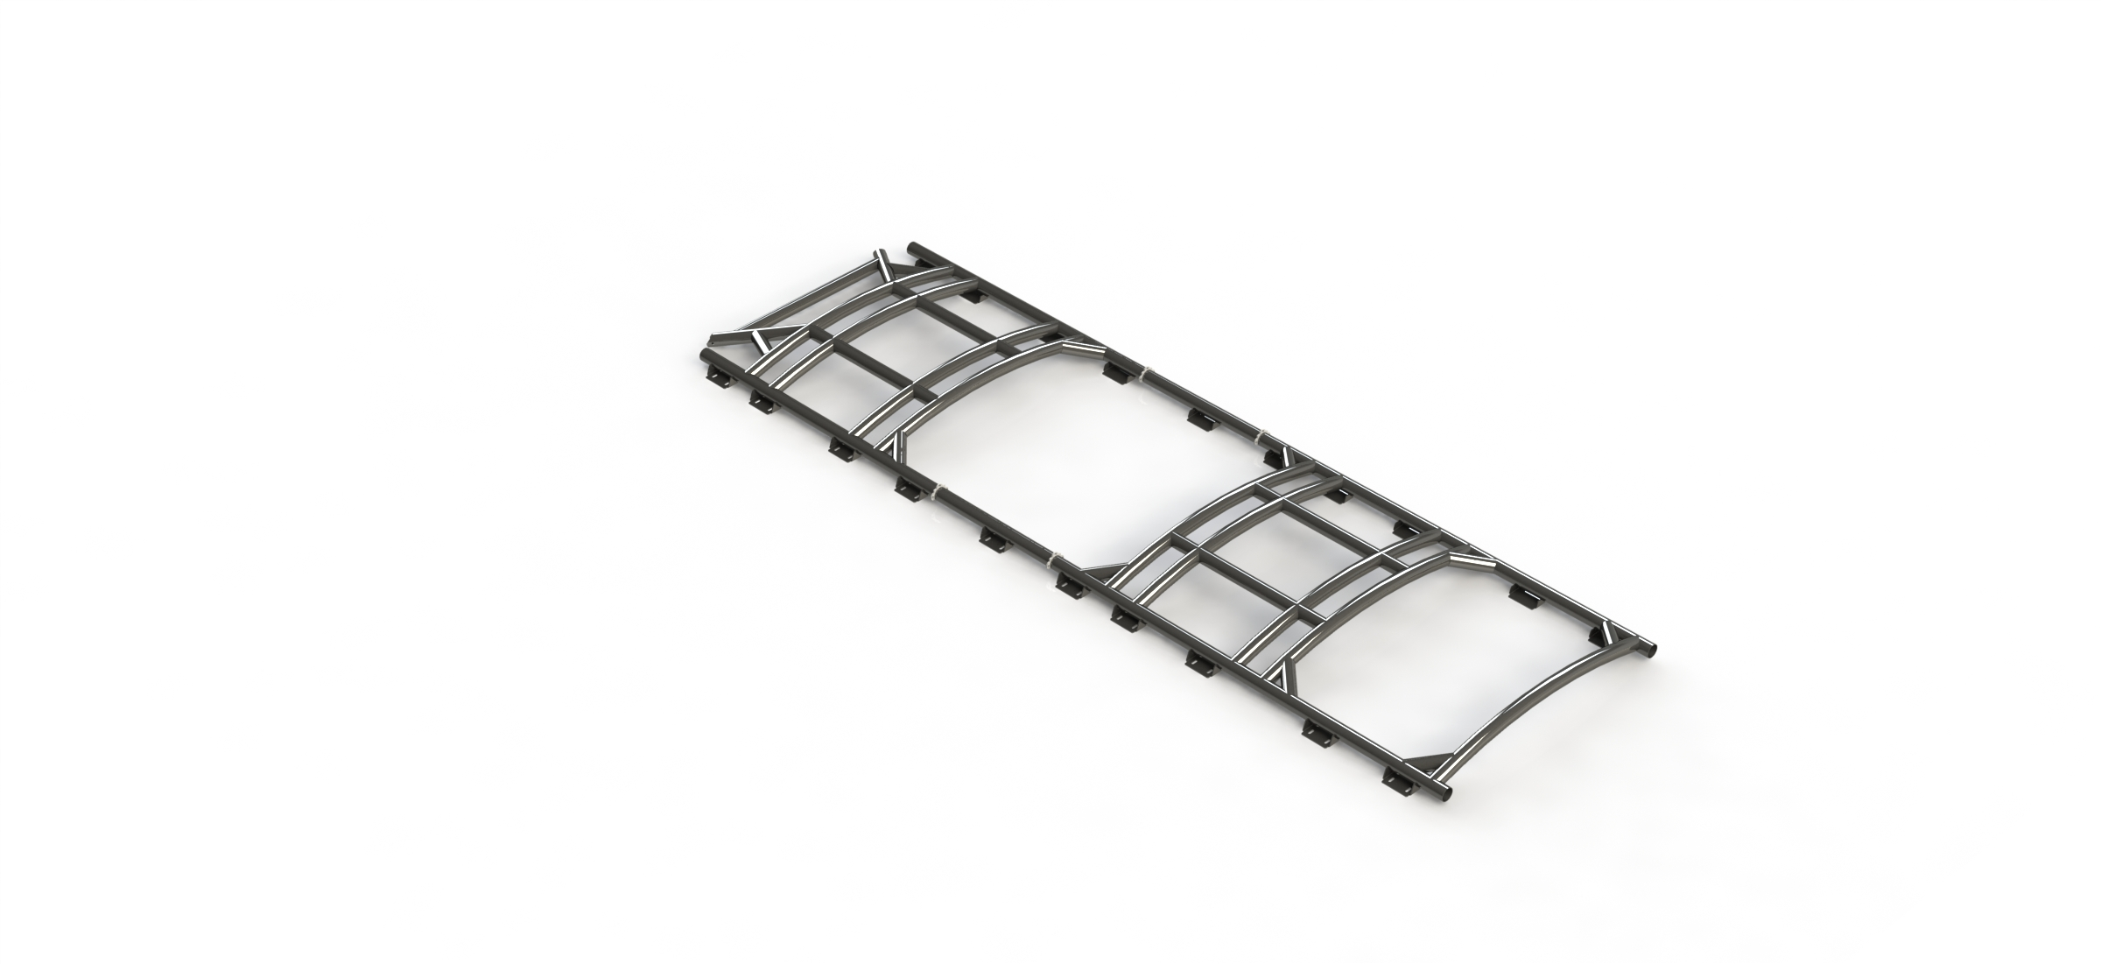
SPRINTER BUS – HALO DESIGN CONCEPT
ISO-VIEW
DIA 63.5 X 3MM
MILD STEEL
550MPA YIELD or 700MPA YIELD
9 HOOPS IN TOTAL
20 FEET IN TOTAL
GRACE MATA FUTI
16-08-2024
AEROKLASDUYS

Slide 6
SPRINTER BUS – HALO DESIGN CONCEPT
Conclusion.
I used Clay Peron ‘s theorem of three moments to find shape factor, the value of shape factor obtained is Ze = 7.534 for the Back Halo with six Hoops, Ze = 6.337 for the Front Halo with six Hoops and the Tube size obtained is Diameter 63.5 x 3mm thick and Diameter 63.5 x 2.5mm Thick respectively, see the handbook of structural steelwork under circular hollow sections or database of structural steel sections. Therefore, design stress in this calculation is equal to the Yield Strength of material because of the Factor of Safety added in the formular under table 1 section 8 in Internation Standard ISO3471 – 2008. I used Vertical Load Force into the longitudinal tube of the HALO system or design. Therefore, the material selection for this design is STRENX 550 or 700MC with Yield Strength of 550MPa or 700MPa or Equivalent Mild Steel with 550MPa or 700MPa and Diameter of 63.5mm x 3mm Thick.
Recommendation:
Finite Element Analysis (FEA) is required to confirm or validate the above calculations and the tube size. The analysis must comply with the ISO3471 – 2008 for the Vertical Load Force, Lateral Load Force, Lateral Energy and Longitudinal Load Force conditions.
GRACE MATA FUTI
16-08-2024
AEROKLASDUYS

Slide 7
SPRINTER BUS – HALO DESIGN CONCEPT
HALO DESIGN FOR SPRINTER – MINIBUS
Name and Surname | Signature | Approved Yes / No | Position
Grace Mata Futi |  | YES | ARKD Principal Engineer
Susie Bozzini |  |  | SEI President
Paul Redelinghuys |  |  | ARKD Engineering Manager
GRACE MATA FUTI
16-08-2024
AEROKLASDUYS

